Slide 1




Data Analysis on Stack Overflow Developer Survey 2019
Jagrit Dewan
Dec 2 2020

Slide 2



OUTLINE
Executive Summary
Introduction
Methodology
Results
Visualization – Charts
Dashboard
Discussion
Findings & Implications
Conclusion
Appendix

Slide 3

EXECUTIVE SUMMARY
In order to keep pace with changing technologies and remain competitive, our organization analyzed survey data to help identify future skill requirements.
Analysis was done on two csv files: Survey Respondent Demographics and Emerging Technologies.
Our organization should focus on developing software and training employees on JavaScript.
Our organization should focus on training and buying/developing PostgreSQL software for our employees.

Slide 4

INTRODUCTION
In order to keep pace with changing technologies and remain competitive, our organization analyzed survey data to help identify future skill requirements.
This presentation identifies trends for this year's report on emerging skills as well as next year's.
It will include easy to interpret and understand visuals created through IBM Cognos Analytics.
This analysis identifies the Top 10 Programming Languages in demand, Top 10 Databases in demand, and the Top 10 Web Frames in demand.

Slide 5

METHODOLOGY
Analysis was done on two csv files: Survey Respondent Demographics and Emerging Technologies.
These files were a subset of a larger survey data on stack overflow.
Data Analysis on the survey data was done through Python 3.7 by cleaning the data, inputting missing values, and visualizing it through scatter, box, and histogram plots.

Slide 6
RESULTS

Slide 7
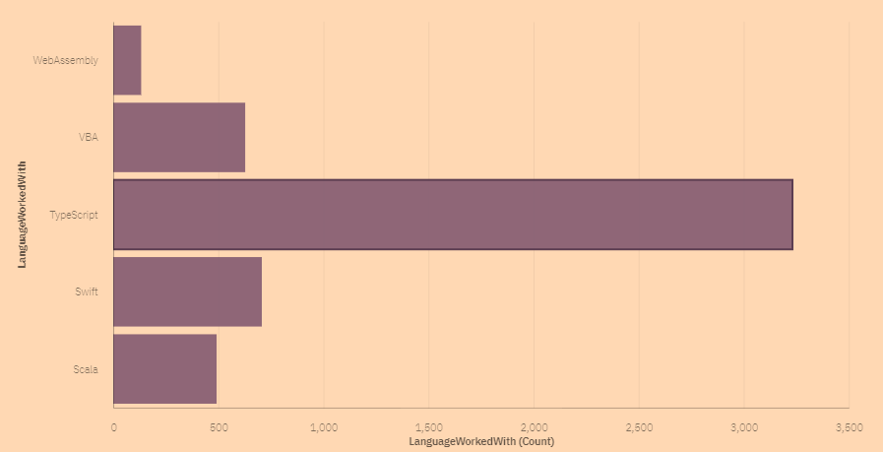
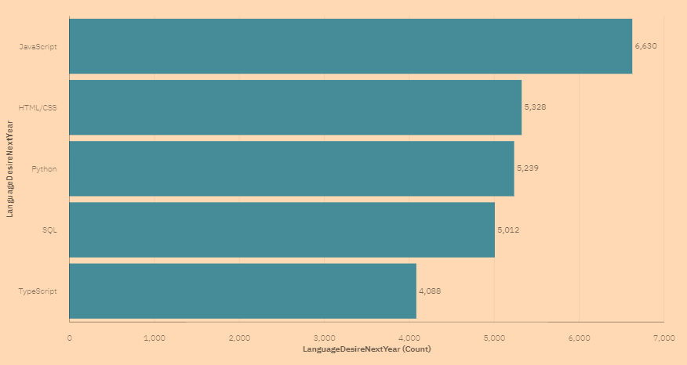
PROGRAMMING LANGUAGE TRENDS
Top 5 Languages for Current Year
Top 5 Languages for Next Year

Slide 8
PROGRAMMING LANGUAGE TRENDS - FINDINGS & IMPLICATIONS
Findings
The most used programming language for current year is TypeScript.
The most in-demand programming language for next year is JavaScript.
Implications
Our organization should focus on developing software and training employees on JavaScript to empower them with the right skills.

Slide 9
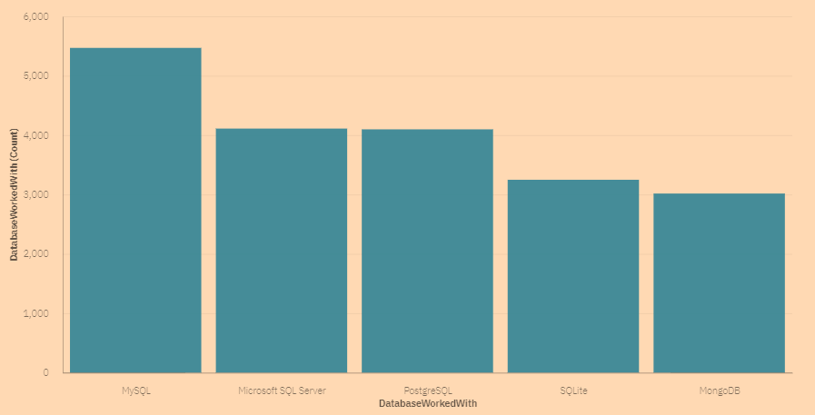
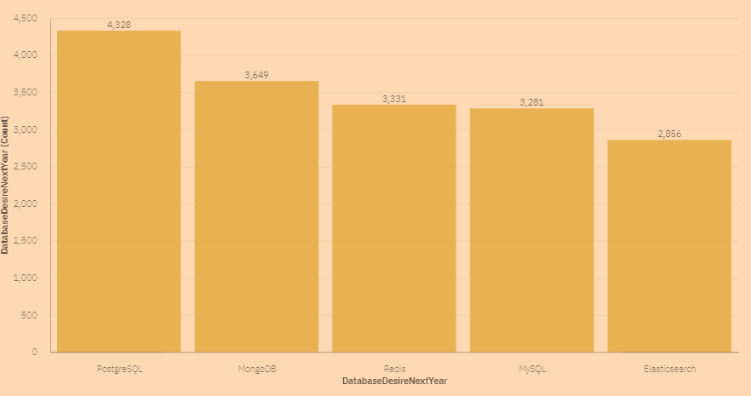
DATABASE TRENDS
Top 5 Databases for Current Year
Top 5 Databases for Next Year

Slide 10
DATABASE TRENDS - FINDINGS & IMPLICATIONS
Findings
The most used database for the current year is MySQL.
The most in-demand database for next year is PostgreSQL.
Implications
Our organization should focus on training and buying/developing PostgreSQL software for our employees.

Slide 11

DASHBOARD
https://us3.ca.analytics.ibm.com/bi/?perspective=dashboard&pathRef=.my_folders%2Fdashboards%2FFuture%2BTechnology%2BTrend&action=view&mode=dashboard&subView=model000001761bcb676c_00000000

Slide 12
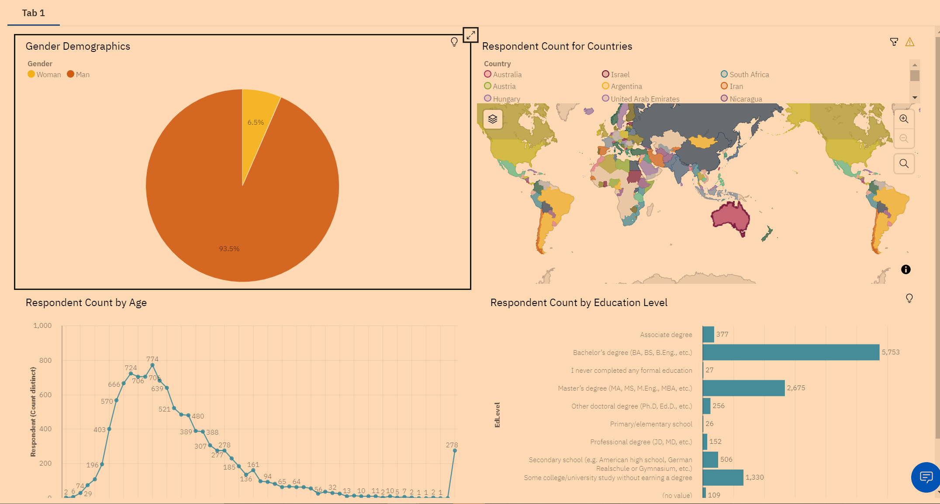
DASHBOARD TAB 1

Slide 13
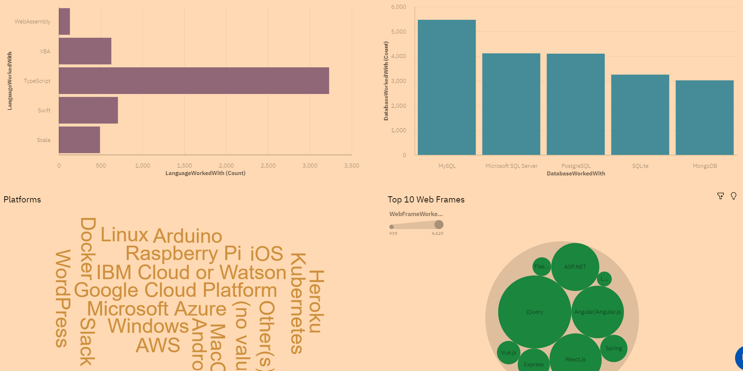
DASHBOARD TAB 2

Slide 14
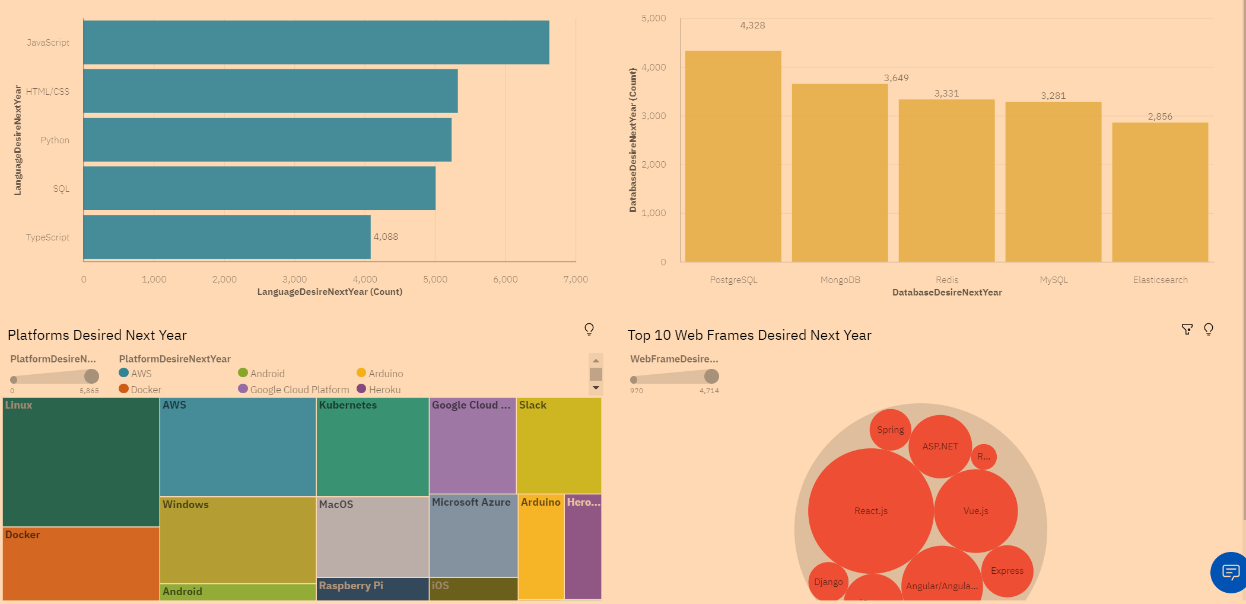
DASHBOARD TAB 3

Slide 15
DISCUSSION
Being able to identify and implement strategies to incorporate the most in-demand technology trends for the next year would give our organization a competitive edge in the market.
We can start by changing the technologies that are currently used to implement the most in-demand technologies.

Slide 16

CONCLUSION
Future skills encourages collaboration, innovation, and transformation which help us to stay competitive and might even give us a competitive edge.

Slide 17
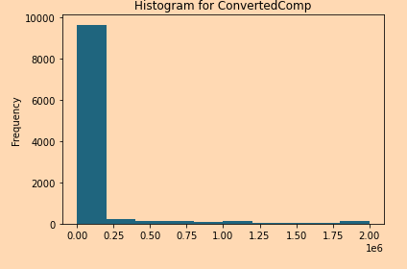

APPENDIX

